Slide 1
„Getting to know European cultural values along religions”
Project no. 2023-1-HU01-KA220-SCH-000161233

Slide 2




Partners and participants
HU – Zsigmond Móricz Reformed College, Kisújszállás
  Monokiné Serege Piroska
GR - Evening High School of Aigaleo, Athens
  Eftyhia Koundouraki
IT - Liceo Scientifico e Linguistico Leonardo, Agrigento
  Paola Patrizia Zarbo
TR - Sultanahmet Suphi Pasa Mesleki ve Teknik Anadolu Lisesi, Istanbul
  Cem Yildiz

Slide 3
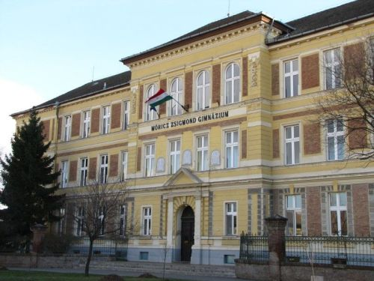


Zsigmond Móricz Reformed College, High School, Technical School, Primary School and Kindergarten
1717 – beginning of grammar school
1717 – 1852 – part of College of Debrecen
II WW - German, soviet military hospital
1948 - nationalization of high school
2012. September – changes of supervisors Reformed Church of Kisújszállás from the Local Government
to strengthen the Reformed faith in our students
Wide range of students
    high rate from neighbouring towns
    20-25 towns, villages
    student hostel (ca. 90 students)

Slide 4
Educational programmes in Móricz
4 year grammar school
5 year language preparatory classes (English, German)
Technical education 5 years
  Information Technology and Telecommunications
  Economy and Management
  Transportation, Shipping and Logistics
  Police and Civil Service
Vocational education 1 year,
  finishes in 2024 because of educational system changes

Slide 5


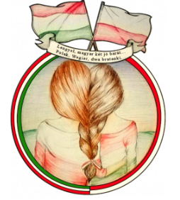

Previous EU projects
„Improving the ability of designing and programming tutorial softwares by using ARCS model”, Leonardo 2012-2014
„Enterprising, healthy and creative” Comenius multilateral partnerships, 2012-2014
„European School Partnership For Sustainability”, Erasmus+, 2014-2016
„A barátságtól az egymástól való tanulásig” Erasmus+, 2016-2018
„Power @pp your learning skills” Erasmus+, 2016-2018
„GOod PrICTices”, Erasmus+, 2019-2022
„Student cooperation for the protection of our environment between the Zsigmond Móricz Reformed College of Kisújszállás and the schools of Wilamowice”, Erasmus+, 2020-2023

Slide 6
Hungarian Erasmus+ team
József Tóth, Headmaster
Piroska Monokiné Serege, Coordinator, English and IT teacher
Szilvia Rácz, Financial manager
Éva Dávid-Bojti, Religious teacher
Beáta Kovács, German teacher
Ferenc Süveges, Economic and IT teacher
Márta-Tóth Szabó, English teacher

